Slide 1
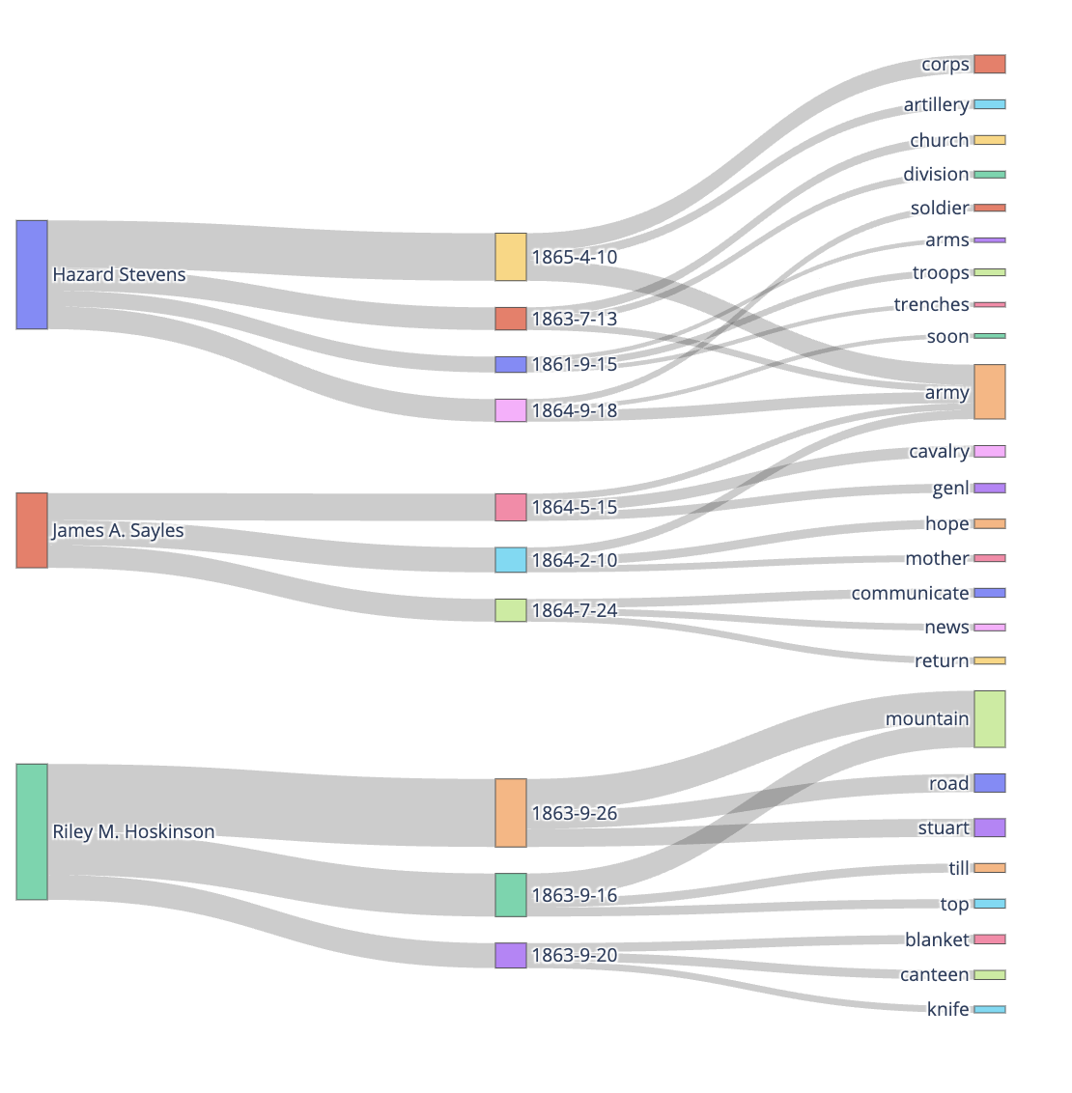
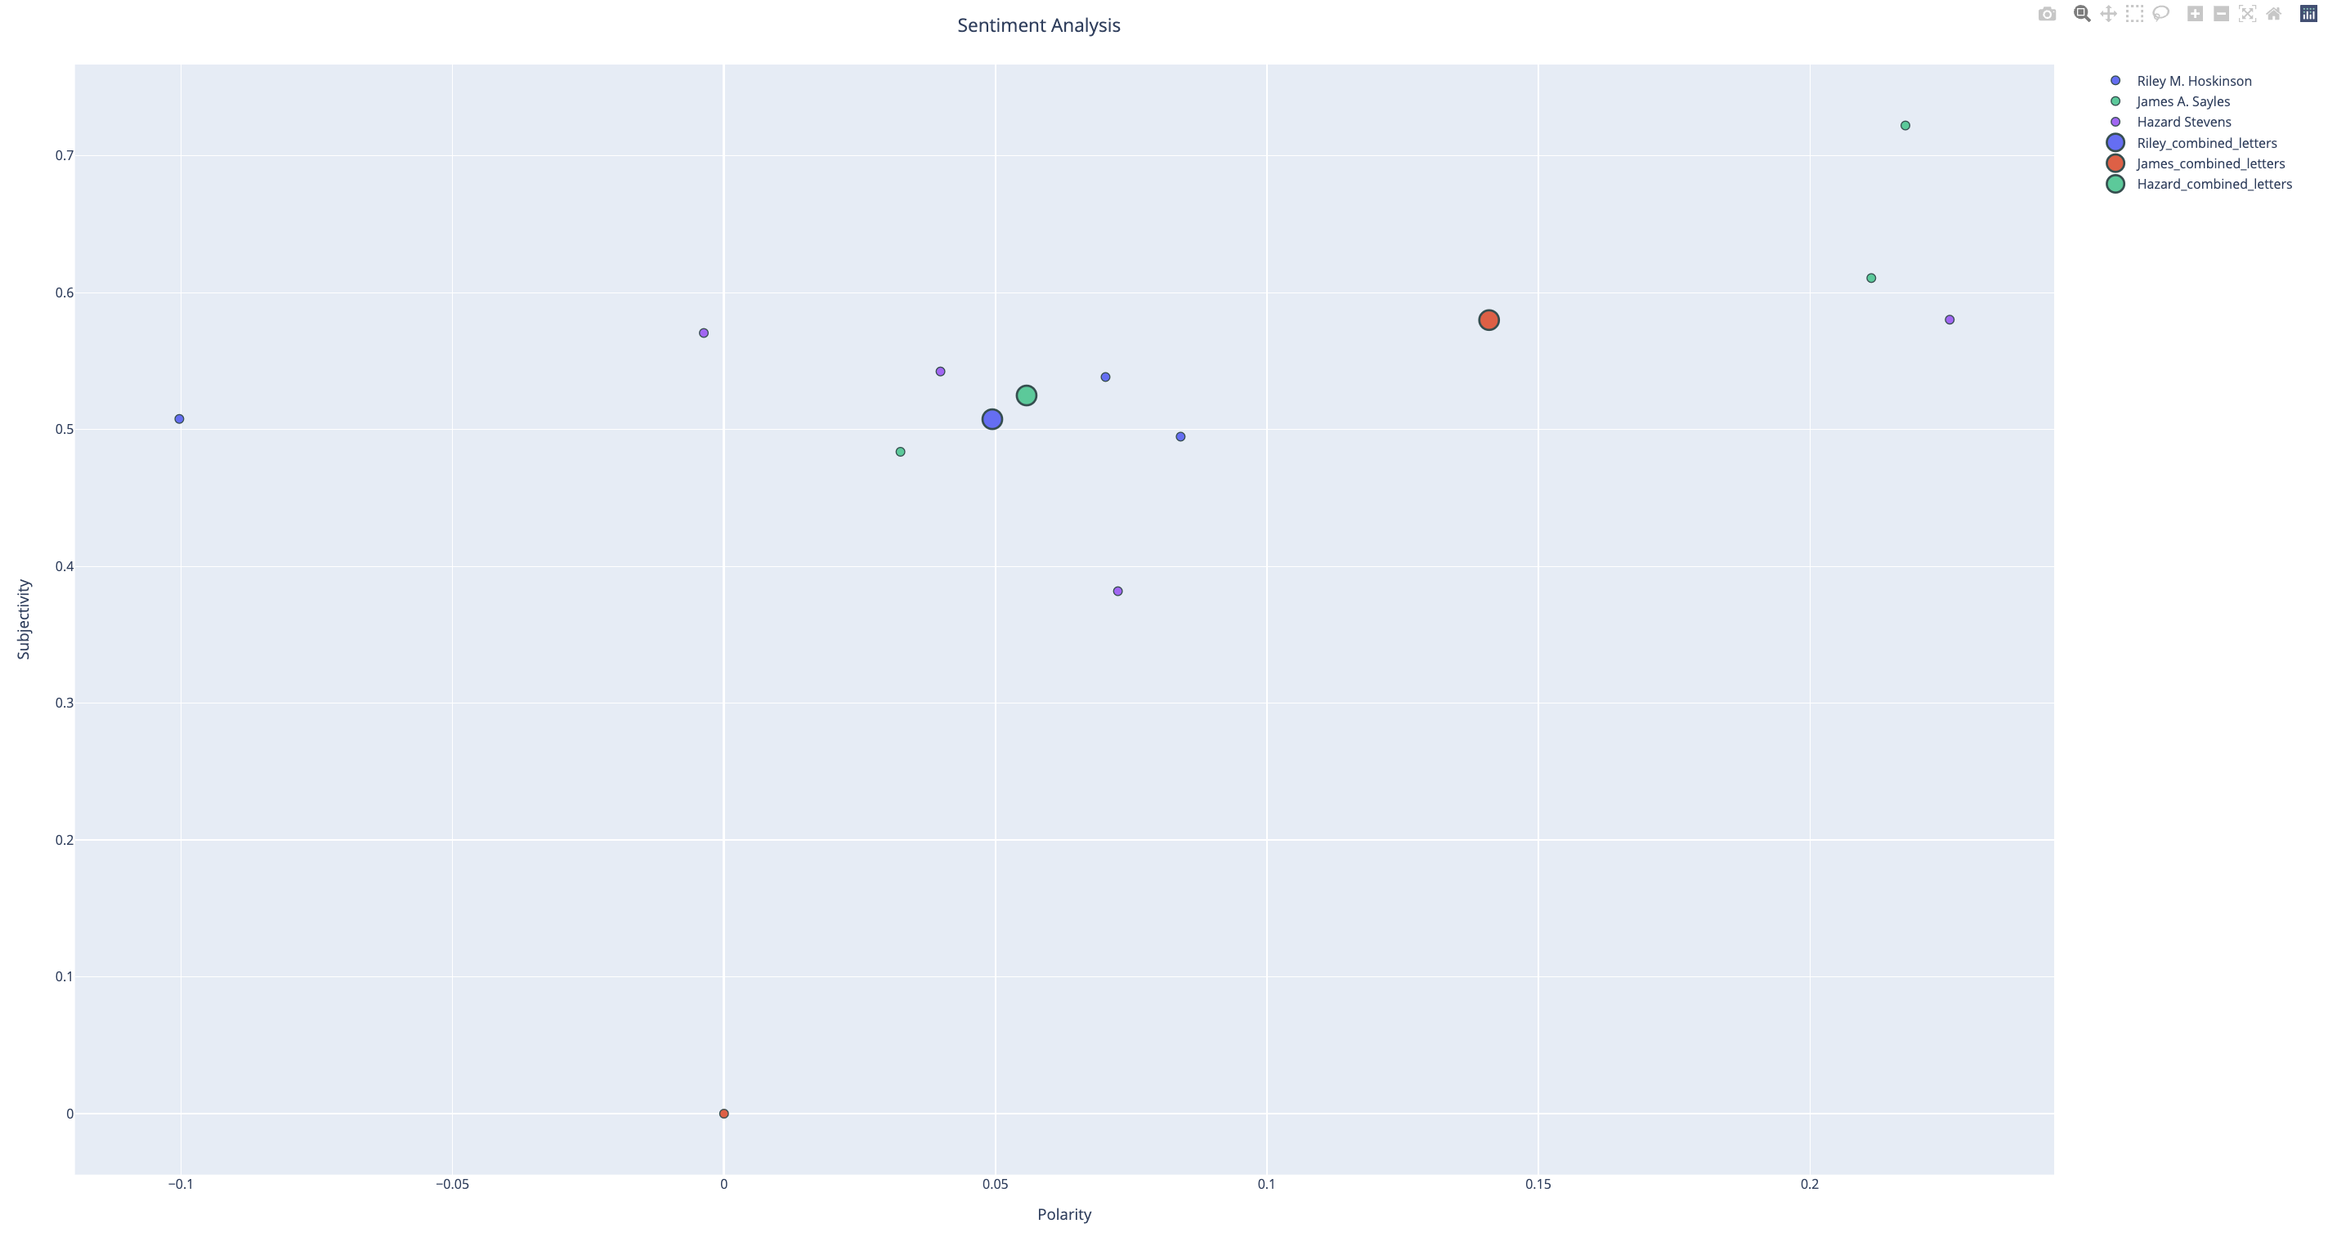
NLP reusable library (letters in the Civil War) Josue Ramirez Antonio, Matthew Xue, Ruhan Xia
Multi-layered Sankey
Sentiment Score Analysis
Sankey diagram: only one word that overlap between 3 authors which is ‘army’
Sentiment diagram: Hazard and Hoskinson both wrote letters with similar subjectivity and polarity.
List of letters in Database. ::: Civil War Letters Collection ::: (n.d.). https://content.lib.washington.edu/civilwarweb/collections.html

